Slide 1
《英语国家社会与文化入门》
The Society and Culture
of Major English-Speaking Countries
An Introduction
(Book 1)

Slide 2
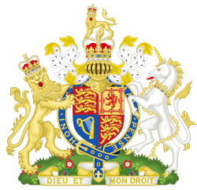
The United Kingdom of Great Britain and Northern Ireland
Unit 3 The Government of the United Kingdom

Slide 3
Quiz
Give the English and a brief explanation for the
following:
内阁
宪法
下议院
上议院
权力法案

Slide 4
Focal Points
The Monarchy
The development of the Parliament
The birth of the Prime Minister and Cabinet
The formation of the British government
- The Constitution
- The power and the functions of the Parliament
- The role of the Monarchy today
The two Houses in the Parliament

Slide 5
The Unit is Divided into Five Sections
I. The Monarchy
II. The Development of the Parliament
III. The Birth of the Prime Minister and Cabinet
IV. The Formation of the British government
Ⅴ. The Two Houses in the Parliament

Slide 6
I. The Monarchy
The Monarchy --the oldest institution of government
The “divine right of kings”
Magna Carta
The civil war

Slide 7
Magna Carta
Magna Carta is a medieval Latin name meaning
“Great Charter”. In 1215, King John was forced
by a group of feudal barons and the Church to
grant them a charter of liberty and political
rights .Magna Carta placed some limits on the
king’s ability to abuse his royal power.

Slide 8
The Civil War
The Civil War was caused by a dispute over the power of the king against Parliament in the 17th century. The Roundheads led by Oliver Cromwell wanted to abolish the monarchy and to reassert the rights of Parliament, but royalists wanted the monarchy to go on. In 1642, the royalist armies were defeated and King Charles I was executed in 1649.

Slide 9
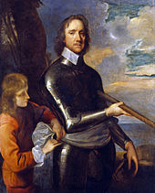
Oliver Cromwell
Oliver Cromwell (1599-1658) was an English military and political leader and later Lord Protector of the Commonwealth of England, Scotland and Ireland.

Slide 10
II. The Development of the Parliament
The establishment of the Great Council by William the Conqueror ;
The first use of the word “parliament” in 1236;
The King or queen meeting regularly with some important MPs to ensure good relations with the Monarchy and Parliament.

Slide 11
III. The Birth of the Prime Minister and Cabinet
The king or queen met regularly with a group of important Parliamentarians known as the Cabinet.
King George I spoke English very badly and was not interested in politics, so he left the job of chairing cabinet meetings to one of his ministers. In time he came to be called the prime minister.

Slide 12
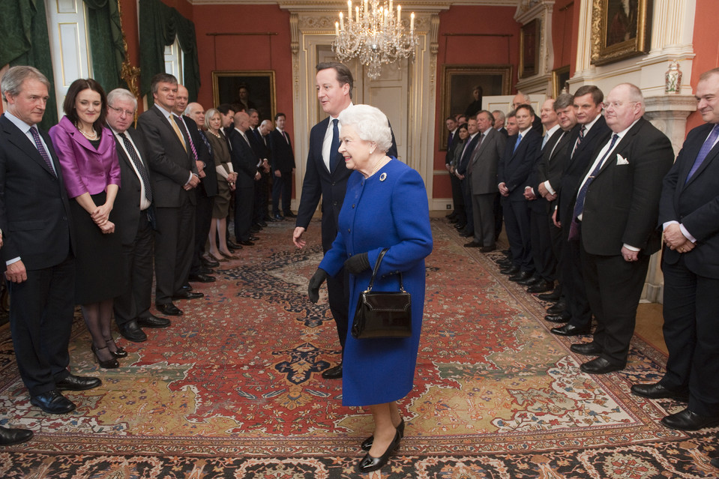
The Queen Meeting With the Members of the Cabinet
Britain's Queen Elizabeth II, center, was accompanied by Britain's Prime Minister David Cameron, center back, as she was presented to members of the Cabinet at 10 Downing Street, London, Tuesday, Dec. 18, 2012.

Slide 13
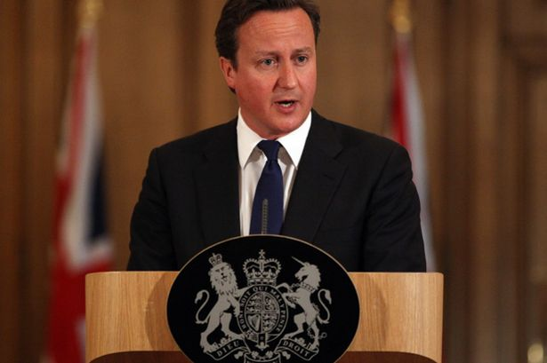
Prime Minister David Cameron
Prime Minister David Cameron holds a press conference at 10 Downing Street.

Slide 14
IV. The Formation of the British Government
British government--- a parliamentary democracy and a constitutional monarchy
The political parties
The Constitution
The power and functions of the Parliament
The role of the Monarchy today

Slide 15
IV. The Formation of the British Government
British government is a parliamentary democracy and a constitutional monarchy.
Great Britain is the oldest Parliamentary democracy in the world , yet it has no written constitution.

Slide 16
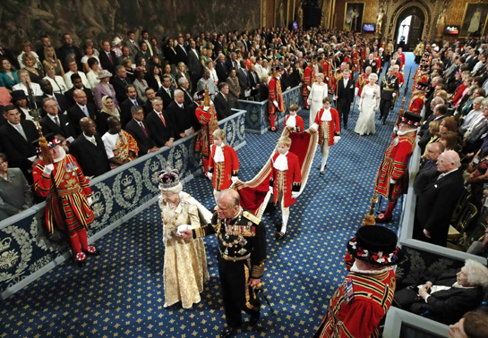
Britain Is Both a Parliamentary Democracy and a Constitutional Monarchy
The State Opening of Parliament marks the commencement of a session of the Parliament of the UK and includes a Speech from the Throne, known as the Queen's (or King's) Speech. The State Opening is an extremely elaborate ceremony showcasing British history, culture, and contemporary politics.

Slide 17
The Constitution
Britain has no written constitution.
The British constitution consists of statue law,
common laws and conventions.
British governance today is based on the terms and conditions of the Constitution.

Slide 18
The Power and the Functions of the Parliament
Passing laws and voting for taxation;
Scrutinizing government policies, administration and expenditure;
Debating the major issues;
Having the power to change the terms of the Constitution;
Making or changing laws ;
Passing any given legislation.

Slide 19
The Role of the Monarchy Today
The symbol of the tradition and unity of the British State;
Legally head of the executive and an integral part of the legislature;
Head of the judiciary and commander in chief of the armed forces;
The temporal head of the Church in England;
Acting as a confidante to the Prime Minister

Slide 20
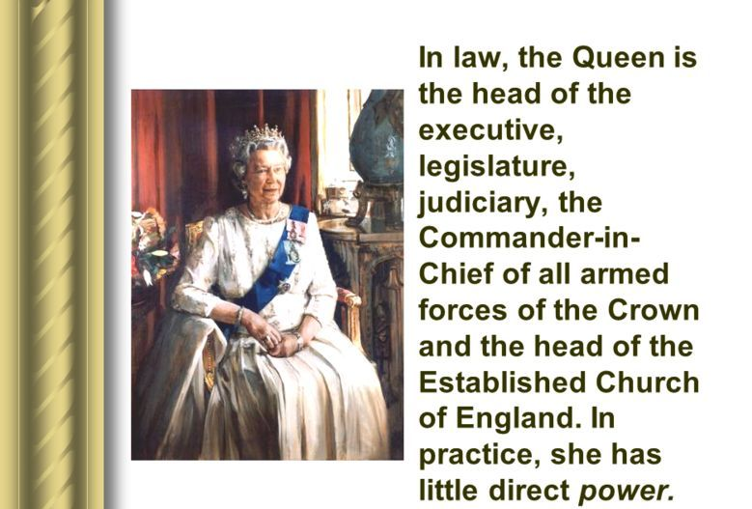
The Queen

Slide 21
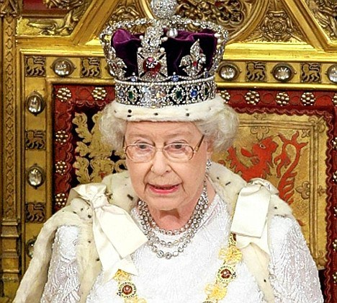
The Queen
The Supreme Governor of the Church of England is a title held by the British monarch. Therefore, Queen Elizabeth II is now the Temporal Head of the Church in England.

Slide 22
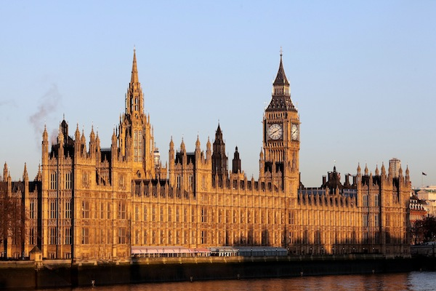
V. The Two Houses in the Parliament
The Palace of Westminster is the meeting place of the House of Commons and the House of Lords of the Parliament. The Palace lies on the Middlesex bank of the River Thames in the central London.

Slide 23
V. The Two Houses in the Parliament
The House of Commons
-consisting of about 650 Members of the Parliament elected by the people;
-most MPs belonging to political parties;
-not only receiving a salary of about ￥64766 but also having allowances for secretaries and researchers, travel and so on.

Slide 24
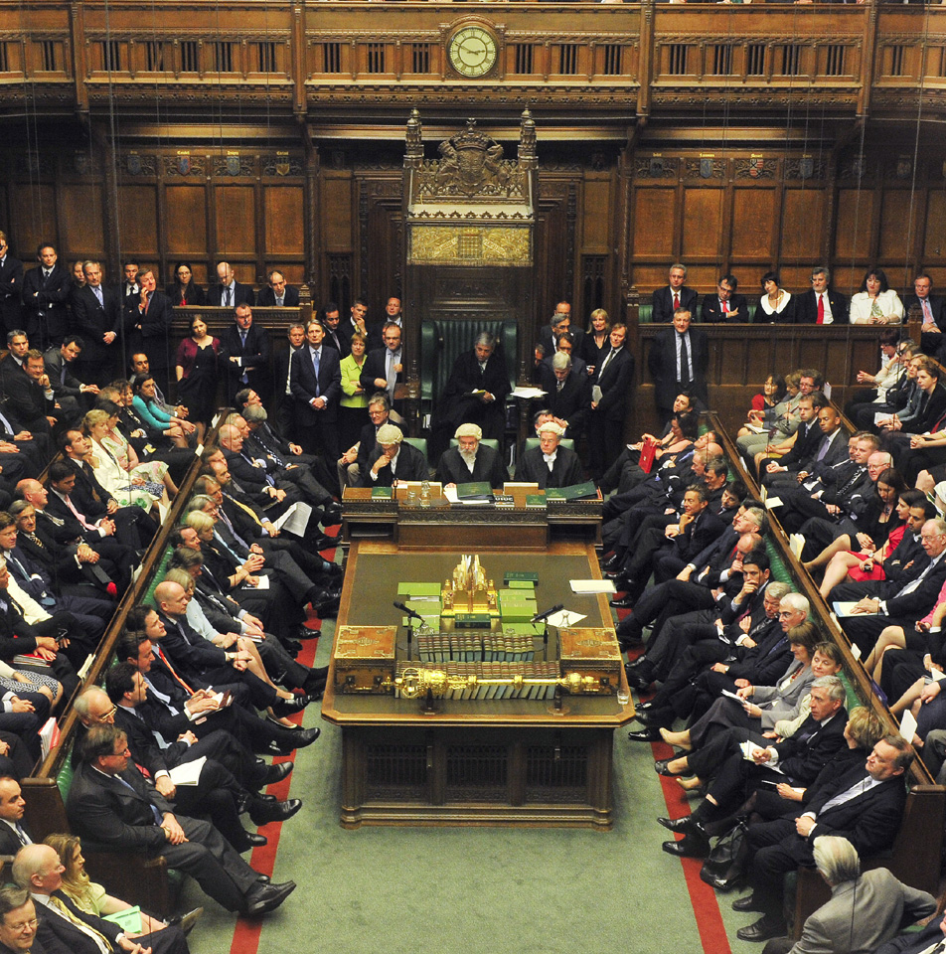
The House of Commons
The House of Commons is a democratically elected
body, consisting of 650 members who are known as Members of Parliament
(MPs). They hold their seats until
Parliament is dissolved (a maximum of five
years after the preceding election).

Slide 25
The House of Lords
The House of Lords:
-consisting of the Lords Spiritual and the Lords Temporal;
-not being elected and only representing themselves;
-without salaries and many not attending parliament ;
-sitting in the Lords either because they have
inherited the seat from their forefathers or because
they have been appointed by the Queen

Slide 26
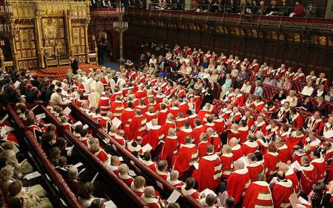
The House of Lords
The House of Lords is the second chamber of the UK Parliament. The Lords share the task of making and shaping laws and checking and challenging the work of the government.

Slide 27
Questions for Discussion
A. How did the Parliament come into being and what functions does it have?
B. What are the major characteristics of the British Constitution?
C. What role does the Queen (King) and the Prime Minister play in the British Government?
D. What kind of institution is the House of commons?

Slide 28
The End
高等教育出版社
2015

